Slide 1
KINGDOM OF IMAGE FORMATS BANQUET MENU

Slide 2
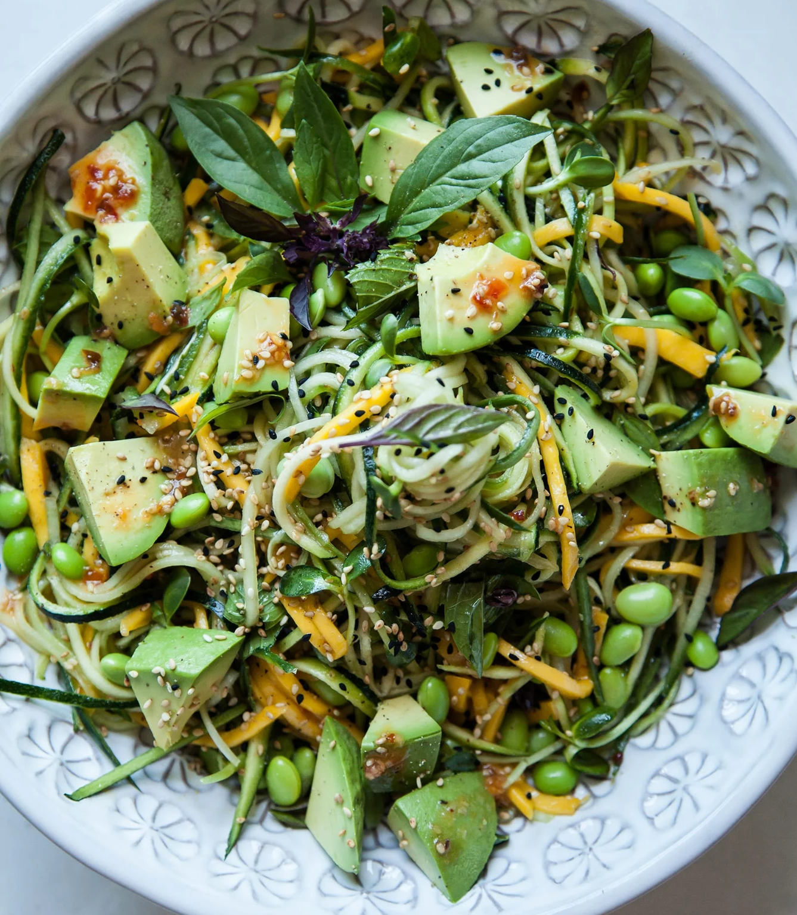
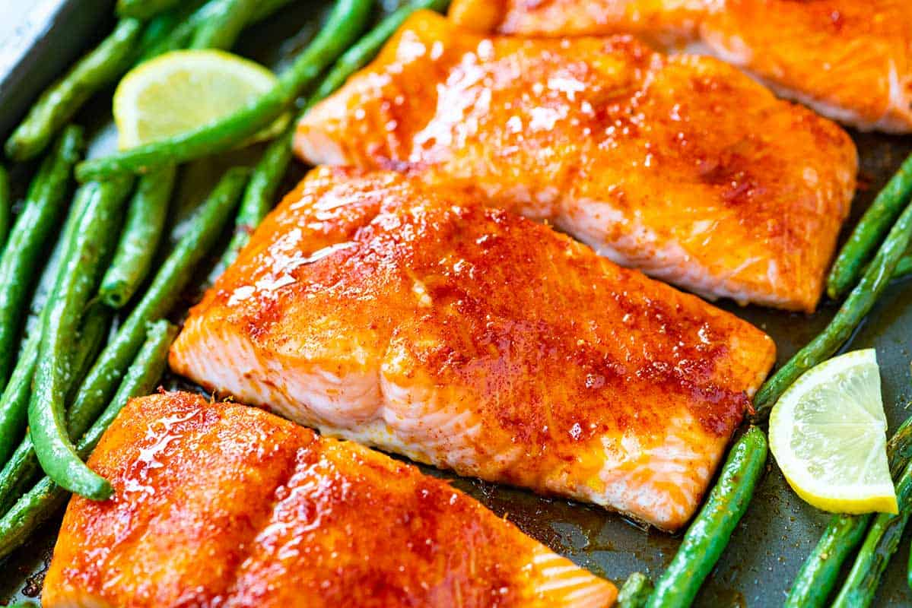
~Welcome to the Royal Banquet~
Enjoy the feast
STARTERS
PNG - GARDEN FRESH SALAD WITH AVOCADO AND SESAME DRESSING
This enticing salad preserves the integrity and vibrant colors of each ingredient (lossless compression). The avocado adds a smooth, buttery texture (transparency), rounding off the dish's fresh, crisp taste with a flawless finish
MAIN DISHES
JPEG - PAN SEARED SALMON WITH CITRUS GLAZE
Full of vibrant flavors (colors). The citrus glaze captures the essence of freshness, but with each bite, its intensity slightly fades (lossy compression). It's perfect for those watching their portions (file size) while still wanting to enjoy a rich, flavorful experience

Slide 3
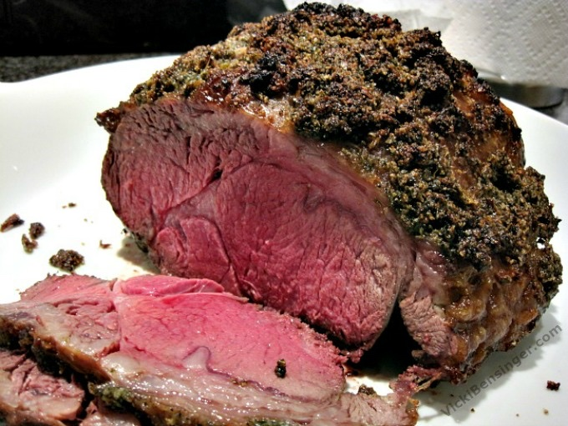
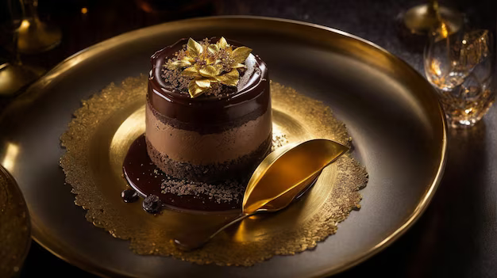
LUXURY BANQUET MENU
MAIN DISHES
BMP - ROASTED HERB CRUSTED PRIME RIB
This dish is all about quality without compromise. Indulgent and hearty (uncompressed), it's served in its full glory, ensuring every bite resonates with unadulterated, succulent goodness.
DESSERTS
TIFF - Decadent Chocolate Mousse with gold leaf garnish
This dessert is the epitome of sophistication (lossless), offering an opulent texture and flavor that stands the test of time. Each spoonful is a testament to its meticulous creation, representing a culmination of the highest quality ingredients (up to 48-bit color) and meticulous preparation

Slide 4
LUXURY BANQUET MENU
DRINKS
GIF - SPARKLING MINERAL WATER WITH LIME
This drink adds a bit of sparkle and movement to your meal without overpowering the senses. It's a light and delightful palate cleanser, perfect for keeping you refreshed throughout the feast.

Slide 5
Chefs:
Aditya
Judith
Omied
Timothy
Vanessa

Slide 6
Food for Thought: The Chefs Journey to Dishing Out Delectable Image Formats

Slide 7
Aditya Saharia
Journal Entry: Learning from the Image Types Project
Initially, I worked with three primary image types: WebP, ARW, and JPEG. Each of these formats has unique characteristics and specific use cases, which I found fascinating.
WebP: This is a modern image format developed by Google. It provides superior lossless and lossy compression for images on the web, resulting in faster loading times and reduced bandwidth usage. I learned that WebP is ideal for web use due to its efficiency in balancing quality and file size
ARW: This is a raw image format used by Sony cameras. ARW files contain minimally processed data from the camera sensor, preserving maximum detail and allowing extensive post-processing flexibility. Working with ARW files taught me the importance of raw formats in professional photography and how they serve as a digital negative.
JPEG: This is one of the most common image formats, known for its balance of quality and file size. JPEGs use lossy compression, which can reduce file size significantly, albeit at the cost of some quality. This format is widely used for everyday photography and web images due to its universal compatibility and efficiency.
The conversion process between these formats and other target formats like TIFF, BMP, PNG, and different variations of JPEG was a critical part of my learning experience.
TIFF: Known for its versatility and high quality, TIFF files are often used in professional environments where image quality is paramount. They support multiple layers and are typically used for storing detailed images that require extensive editing.
BMP: An older, uncompressed format, BMP files are simple but result in large file sizes. They are less common today but are still used in certain applications where simplicity and compatibility are essential.
PNG: This format provides lossless compression, making it ideal for images that require transparency and high quality without losing any detail. PNG is widely used on the web for graphics and images that need to maintain clarity.
During the project, I utilized various tools and software to perform these conversions, learning about the strengths and weaknesses of each format. For example, converting an ARW file to TIFF retains the high quality necessary for detailed editing, while converting it to JPEG is useful for sharing on the web. I also discovered that converting images can involve trade-offs between file size, quality, and compatibility.
Additionally, I learned about the limitations of different platforms, specifically that Google

Slide 8
Judith Barrios
ITAI 1378 Computer Vision
Patricia McManus
Royal Banquet Menu Entry
In the quest we were supposed to create a royal banquet menu, where we present a different dish with all kinds of formats, and describe the characteristics and uses of the formats in delicious and tasty ways.
06/25/24
We picked different dishes like salmon, salad, ribs, etc. We learned about various image formats, like JPEG, which is a widely used image compression format that is used for high-quality image storage with efficient file sizes. It is ideal for photographers and difficult images because it discards some image data to reduce file size. There is also PNG (portable network graphics), which is quite a popular one to preserve image quality without having to get rid of details. It supports transparency images with high quality, such as logos and graphics with sharp corners. BMP (bitmap) is another image format that was developed by Microsoft, it stores color data for each pixel without compression. This results in larger file sizes but it preserves the quality, it is not commonly used online like other formats. Lastly, we learned about TIFF (tagged image file format), which is a versatile format that stores raster graphics, supporting a lot of color depths and compression methods. It is widely used in fields like photography and printing, because it preserves high quality photos. All these formats have many advantages and are very easy to use for images. We approach the challenge with open thoughts and researched a lot about the formats, and put together dishes that sound exclusively delicious and appealing to the audience. It was difficult to choose a dish, because it was time consuming and hard to find the right words to make them sound good for the menu. However, this quest has given us more knowledge about formats and how to apply them to images for the future.
References:
Nichols, Jessie-Lee. “10 Types of Image File Extensions and When to Use Them.” HubSpot
Blog, HubSpot, 22 Aug. 2023, blog.hubspot.com/insiders/different-types-of-image-files.

Slide 9
Reflection on A04 – Omied Willis
The Daedalus Group selected Kingdom of Image Formats – Challenge 1 for our A04 assignment. During the course of this assignment we came to better understand some of the image formats that we have used for years, but to which I hadn’t paid much attention to until this point. I learned how JPEGs, PNGs, BMPs, and TIFFs all come with advantages and trade-offs; and each is best suited to their own specific use case. In much the same way that our food differs in the way we prepare and serve it based on the intended audience(you wouldn’t try to microwave Thanksgiving dinner, would you?), image formats should be carefully chosen based upon their required context in very much the same way.

Slide 10
A04 "Image Processing Adventure Quest" Journal Entry by Timothy Williams
Picture this: You're at a grand feast celebrating the world of digital images. Each image format is like a unique dish, bringing its own flavor to the table.
JPEG, our main course, is the crowd-pleaser. It's like that perfect balance of taste and portion size - not too heavy, not too light. Just as we adjust our eating habits to different situations, JPEG adapts to various digital environments. It's the chameleon of the image world, fitting in everywhere from your aunt's Facebook posts to professional photography websites.
Next, we have PNG, the crystal-clear soup of our digital banquet. It's like looking through the clearest glass, where you can see every detail of the broth. PNG's transparency is its superpower - imagine logos floating effortlessly on websites, or intricate designs that blend seamlessly with any background.
Then comes GIF, the life of the party. It's the dessert that keeps on giving, like an endless chocolate fountain. GIFs bring movement and laughter to our digital conversations, looping endlessly like that catchy tune you can't get out of your head.
BMP is the traditional dish on our menu. It's like a meticulously hand-painted work of art - beautiful in its detail, but perhaps a bit too heavy for everyday consumption. It's the format you appreciate for its craftsmanship but don't necessarily want to carry around.
Finally, we have TIFF, the grand finale of our image format feast. It's like walking into a luxurious banquet hall, where every tiny detail of the decor is captured in stunning clarity. TIFF is for those moments when you want to savor every pixel, every nuance of an image.
Each of these formats brings something special to our digital dining experience. Just as we choose different foods for different occasions, we select these formats based on our digital needs. It's a reminder that in both food and files, variety is the spice of life!

Slide 11
Vanessa Bersola
This assignment has given me a better understanding of each image format. Making a comparison with food has helped me remember some of the small details that differ for each file type.
A GIF is one of the more popular file types with a limitation of 256 colors, therefore the file size is small. It uses a lossless compression meaning there is no data lost while it is being compressed. It is perfect for making logos and short animations. This is why the sparkling water was so fitting because the bubbles move, giving more life to plain still water. It’s also the smallest item and served almost everywhere, just like how GIFs can be used in most browsers.
TIFF files are the opposite, they are high quality, lossless images that result in large file sizes. They are used in photography and can have multiple layers, unlike JPEG which only has one. The chocolate mousse embodies all these characteristics as far as taste, layers, and even high in calories (file size haha).
BMP files are uncompressed, are large in size, but no loss of quality. It has a simple structure program wise. They are not used in web graphics because of size but are easy to edit using only a single layer. This is why the prime rib represents this beautifully. An large uncomplicated dish that can still deliver delectable flavor.
Now we get to PNG and JPEG. PNG is lossless compression but a larger file size than JPEG. JPEG is different from all the other file types in that it has a reduced file size by losing quality of the image. Both are very good for website usage. The salmon is a great symbol for JPEG because it is low in calories (size) and can still bring decent quality to the table. PNG as a salad is great because you can still have a filling meal thanks to the avocado, and it goes great with everything as a starter.
I approached this challenge by asking Claude AI what the differences between each file types were and then discussing with my teammates what each image closely resembles. Then we agreed to find a photo in its corresponding image type that represented the menu item. The salmon photo is a JPEG, the salad is a PNG, etc. Overall great project that was fun, mouth watering, and educational.
References:
Anthropic. (2024). Claude AI (Version 3.5 Sonnet). Retrieved [June 24, 2024] from https://www.anthropic.com https://claude.ai/chat/48c880ba-46bd-47ec-920a-05a5861167d5

